Slide 1
Malachi
The 2nd conversation
Thynne Road
14 April 2024

Slide 2
Some background
Malachi’s name means ‘my messenger’
Malachi lived around 450 BC
Malachi lived around the same time as Ezra and Nehemiah
The wall and the temple had been rebuilt and the temple was operating
The people faced economic hardship
The people were in a state of spiritual decline.

Slide 3
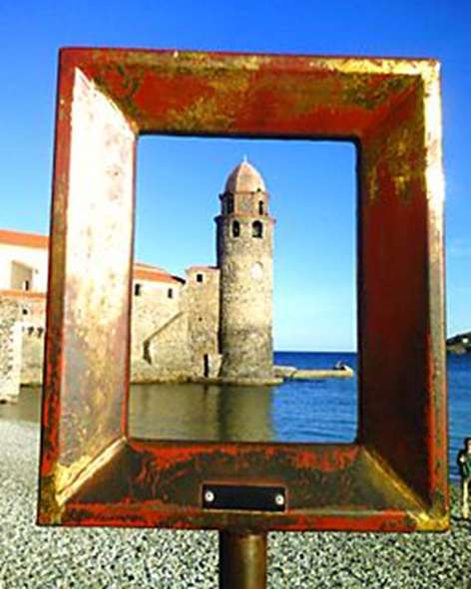
What do you see?

Slide 4
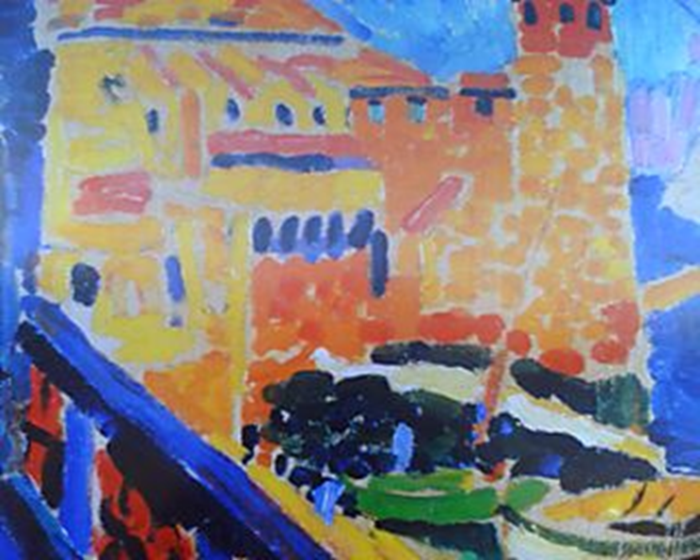
What do you see?
Le phare (lighthouse)de Colliore
Andre Derain - 1905

Slide 5
Key phrases spoken by the Lord Almighty
Where is the honour and respect due me?
Offering defiled food on my altar
Blind, diseased and lame animal offerings – is this not wrong?
Oh that one of you would not shut the temple doors – so that you would not light useless fires on my altar
My name will be great among the nations
Cursed is the cheat

Slide 6
Romans 12:1-2
‘Therefore I urge you, brothers and sisters, in view of God’s mercy to offer your bodies as a living sacrifice, holy and pleasing to God – this is your true and proper worship. Do not conform to the pattern of this world but be transformed by the renewing of your mind. Then you will be able to test and approve what God’s will is – His good, pleasing and perfect will.’

Slide 7
Bring our best
Church attendance and ministry;
Prayer life;
Financial giving;
Use of time or gifts;
Hospitality;
The way that we treat strangers;
How we encourage others;
Etc. etc.

Slide 8
Bring our best
Church attendance and ministry;
Prayer life;
Financial giving;
Use of time or gifts;
Hospitality;
The way that we treat strangers;
How we encourage others;
Etc. etc.
That will do attitude

Slide 9
Bring our best
Church attendance and ministry;
Prayer life;
Financial giving;
Use of time or gifts;
Hospitality;
The way that we treat strangers;
How we encourage others;
Etc. etc.
Health Warning
That will do attitude

Slide 10
The Context of Romans 12
Preceding chapters – Paul spells out all that God has done for us;
Therefore = in recognition of that sacrifice;
We are part of the Body of Christ;
To show love in action;
Out of joy and nor burden.

Slide 11
The Context of Romans 12
Preceding chapters – Paul spells out all that God has done for us;
Therefore = in recognition of that sacrifice;
We are part of the Body of Christ;
To show love in action;
Out of joy and nor burden.
May require sacrifice

Slide 12
Preserve Knowledge
Paul and the Bereans – Acts 17;
My truth and your truth;
Word of God is the truth.

