Slide 1
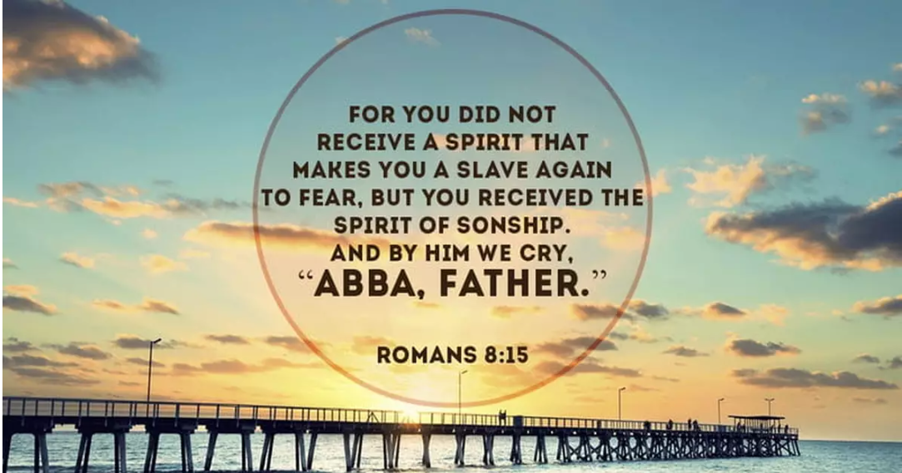
Abba, Father!

Slide 2
Our earthly experience
Whatever our experience has been, our earthly fathers are a shadow of our heavenly one!

Slide 3
Attributes of our Heavenly Father
The author of all life
1 Corinthians 8:6 Yet for us there is one God, The Father, from whom are all things and for whom we exist.
Our personal creator!
Psalm 139: 13 For you formed my inward parts; you knitted me together in my mother’s womb.
Protector of the weak and vulnerable
Psalm 68:5 Father of the fatherless and protector of widows is God in his holy habitation.

Slide 4
Attributes of our Heavenly Father
Abounding in love John 3:16 For God so loved the world that he sent his only son…. I John 3:1 See what kind of love the Father has given to us, that we should be called children of God; and so we are.
Strict yet loving Proverbs 3:11,12 My son, do not make light of the Lord’s discipline, and do not lose heart when he rebukes you, because the Lord disciplines the one loves and he chastens everyone he accepts as his son.
Merciful and comforting
2 Corinthians 1:3-4 ..the Father of mercies and God of all comfort.

Slide 5
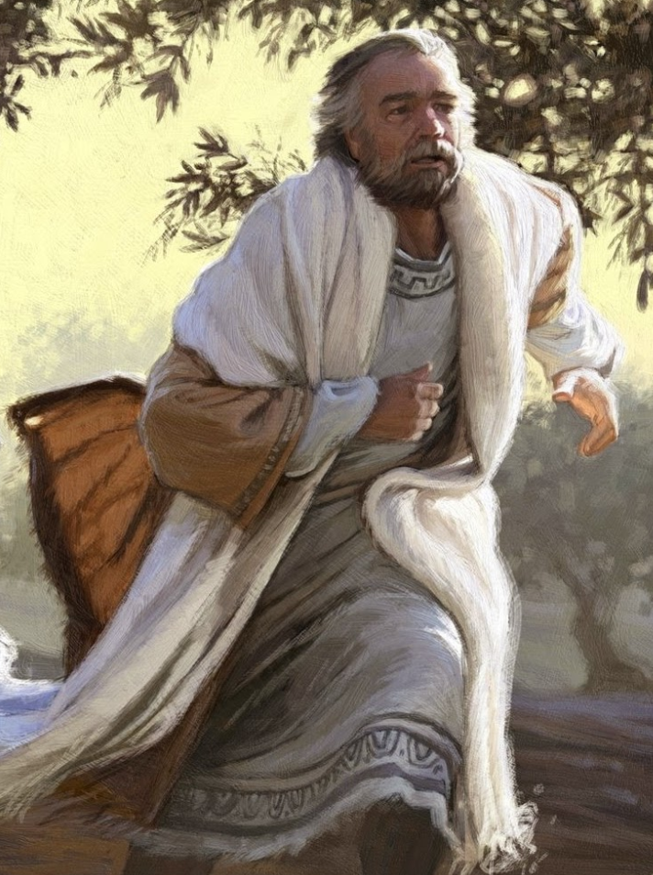
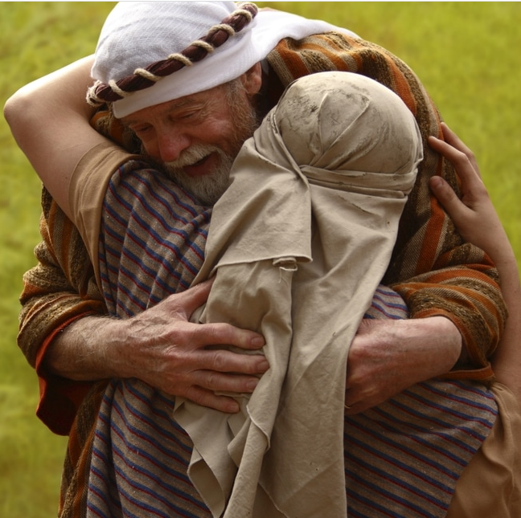
The loving, caring, forgiving Father
Luke 15: 20 …But while he was still a long way off, his father saw him and was filled with compassion for him; he ran to his son, threw his arms around him and kissed him..

Slide 6
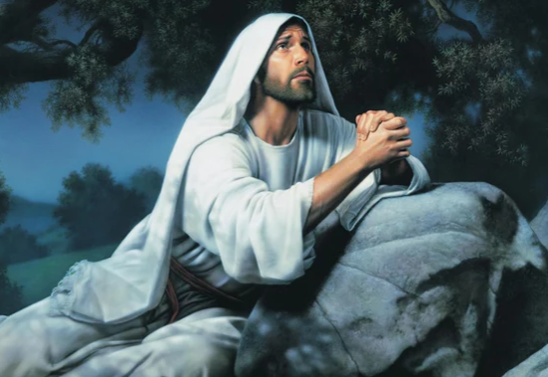
Abba, Father!
Mark 14 v 36
“Abba, Father,” he said, “everything is possible for you. Take this cup from me. Yet not what I will, but what you will..”

Slide 7
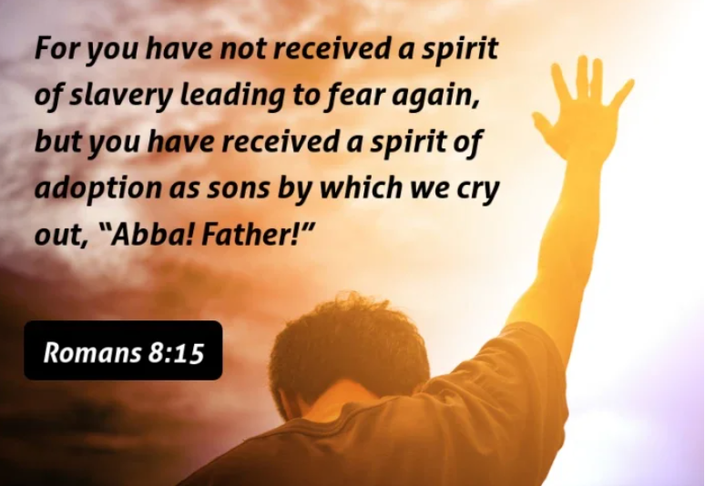
Abba, Father!

Slide 8
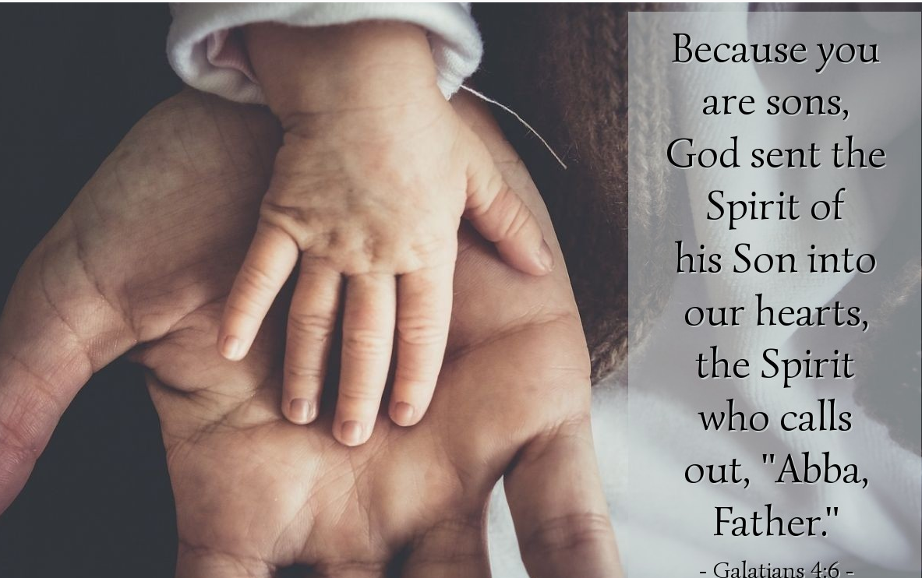
Abba, Father!

Slide 9
Abba, Father!
Galatians 4:4-6
4 But when [in God’s plan] the proper time had fully come, God sent His Son, born of a woman, born under the [regulations of the] Law, 5 so that He might redeem and liberate those who were under the Law, that we [who believe] might be adopted as sons [as God’s children with all rights as fully grown members of a family]. 6 And because you [really] are [His] sons, God has sent the Spirit of His Son into our hearts, crying out, [a]“Abba! Father!”

Slide 10
Abba, Father!
Romans 8:16
The Spirit himself testifies with our spirit that we are God’s children.
It’s not a passive experience! Our spirit joins with the Holy Spirit to worship God and recognise our identity.

Slide 11
Abba, Father!
We have God as our Father.
He has paid for us.
He has adopted us.
He cares for us.
He wants us.
He loves us.
He protects us.
He provides for us.
He has made us an heir (co-heir with Christ) of all that he owns.
God is our father!

